Slide 1
Studies Recommendations
Group Member:
Hanin Alhaidar-221443112
Noor Alkhars-221442406
Fatima Yousef-221435976
Malak Abdullah-219041579
Instructor Name:
Dr.Hala Hamdoun

Slide 2
Introduction
The role of recommendation systems comes as cornerstone in helping students make informed decisions about their educational and career paths, where proper guidance of students towards a bright future is increasingly important. This project aims to develop an intelligent system for providing customized study recommendations, using machine learning algorithms. By analyzing students’ data, such as their academic performance and interests, the system will provide accurate recommendations on the best disciplines that suit each student. Through this system.

Slide 3
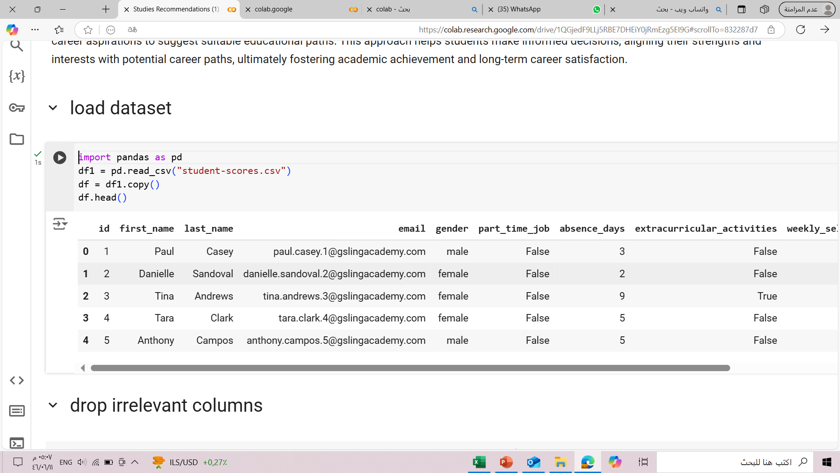
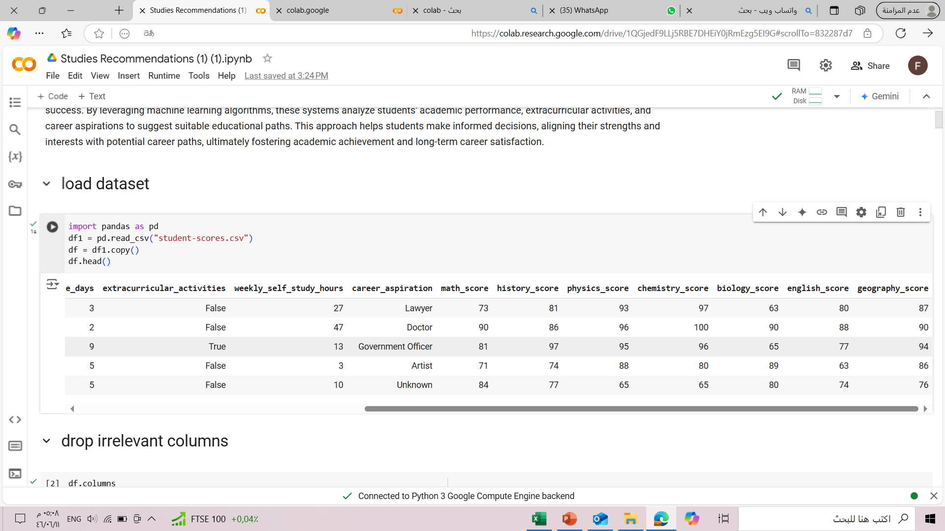
Data Description
Dataset Name: student-scores.csv
The file contains information about 2000 students.
The data includes information about:

Slide 4
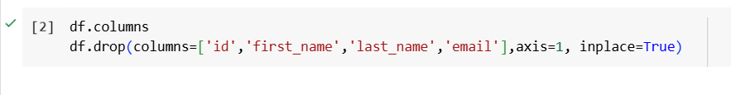
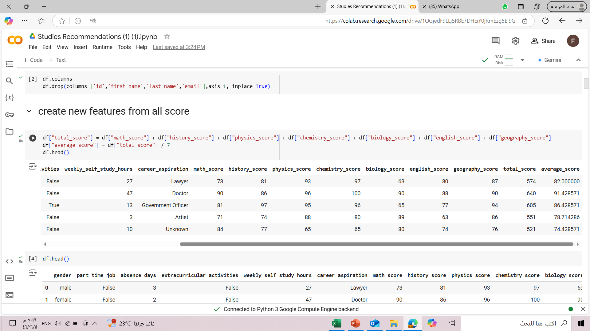
System Building Stages
1.Data cleaning: Removing Unnecessary columns from data
2.Create Feature: Creating New features from, such as:
The average score for each student was calculated in a new column called "average score" by dividing the "total score" by the number of subjects.

Slide 5
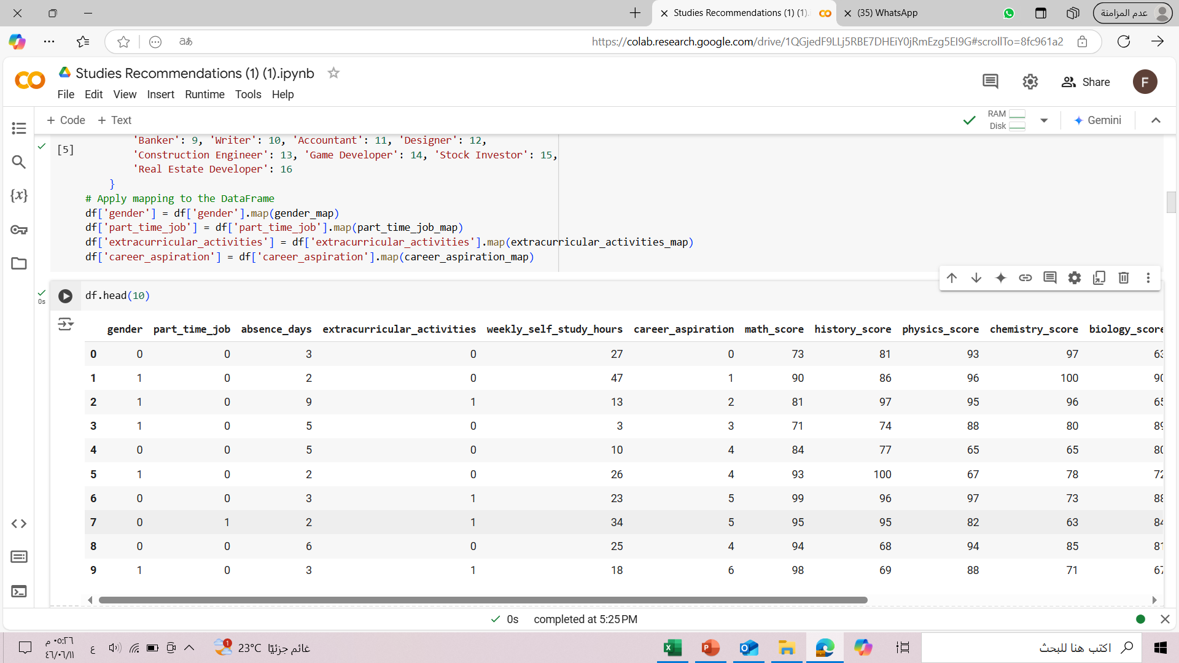
System Building Stages(cont..)
3. Data encoding: Converting Categorical data into numerical data :
The values for "gender" were converted to (0,1),
and The values for "part-time job" (True/False) were converted to (1,0),
Also The values for "career aspiration" were converted to different numbers for each job (e.g., 0 for lawyer, 1 for doctor, and so on).

Slide 6
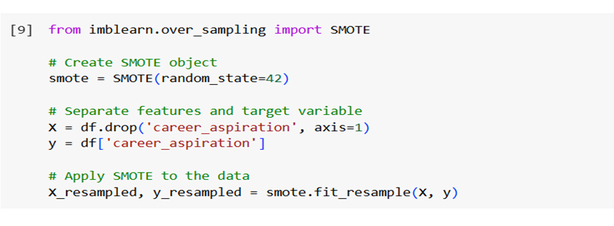
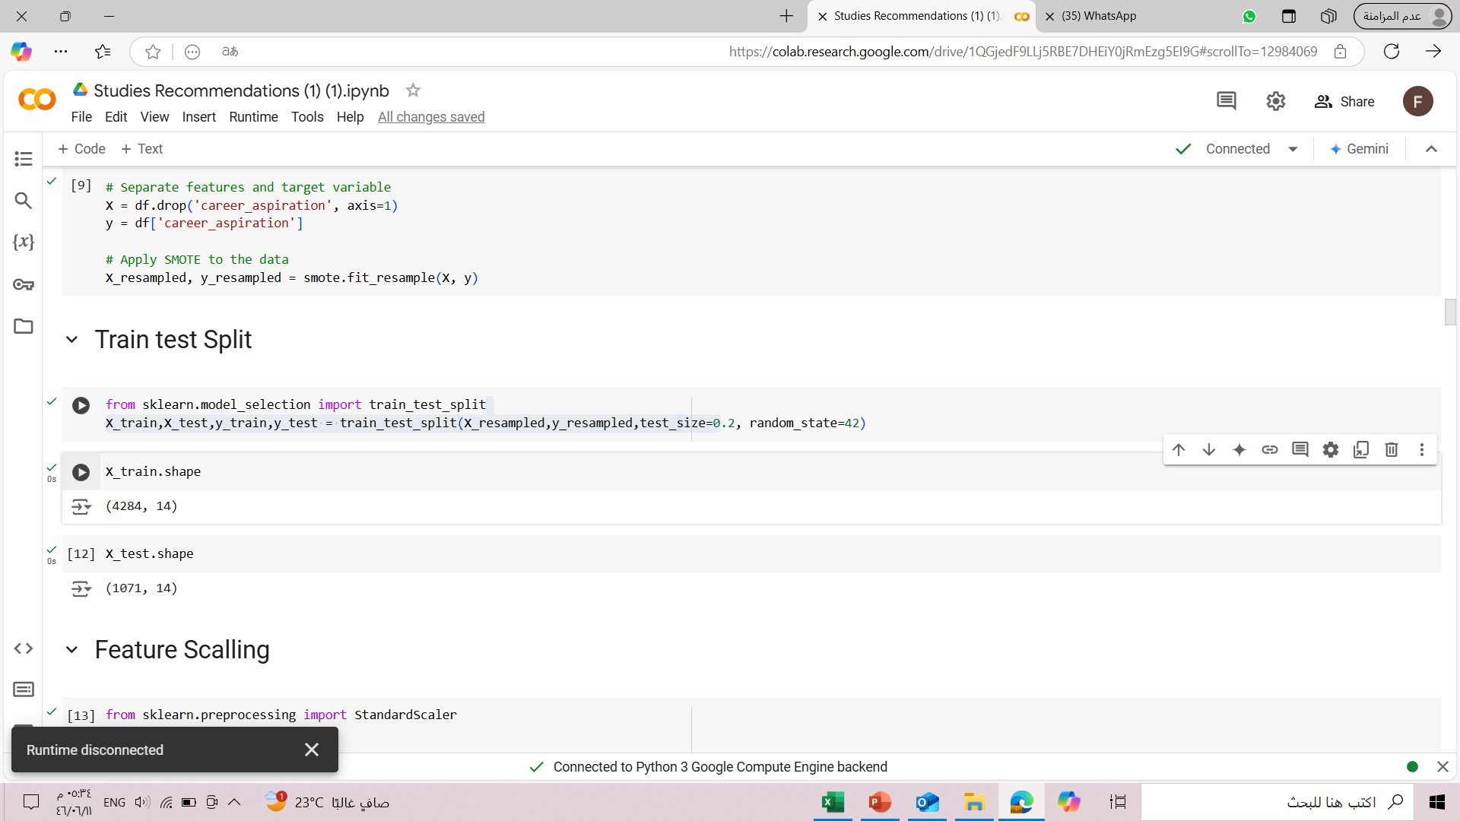
System Building Stages(cont..)
Data balancing:
Data imbalance can lead to bias in the machine learning model, so the SMOTE technique was used to create synthetic samples for the under-represented categories and achieve a better balance.
5. Data splitting:
Splitting the data into training data (80%) and testing data (20%).
Splitting the data is necessary to train the machine learning model on a portion of the data and then test it on another portion that was not used in training, in order to measure the model's performance and its ability to generalize.

Slide 7
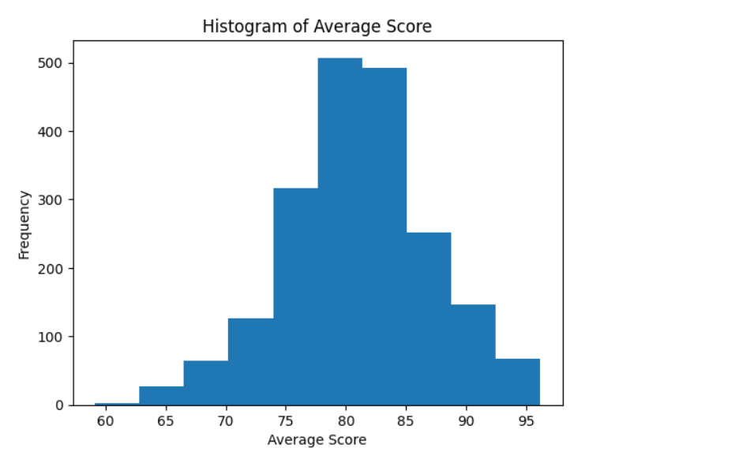
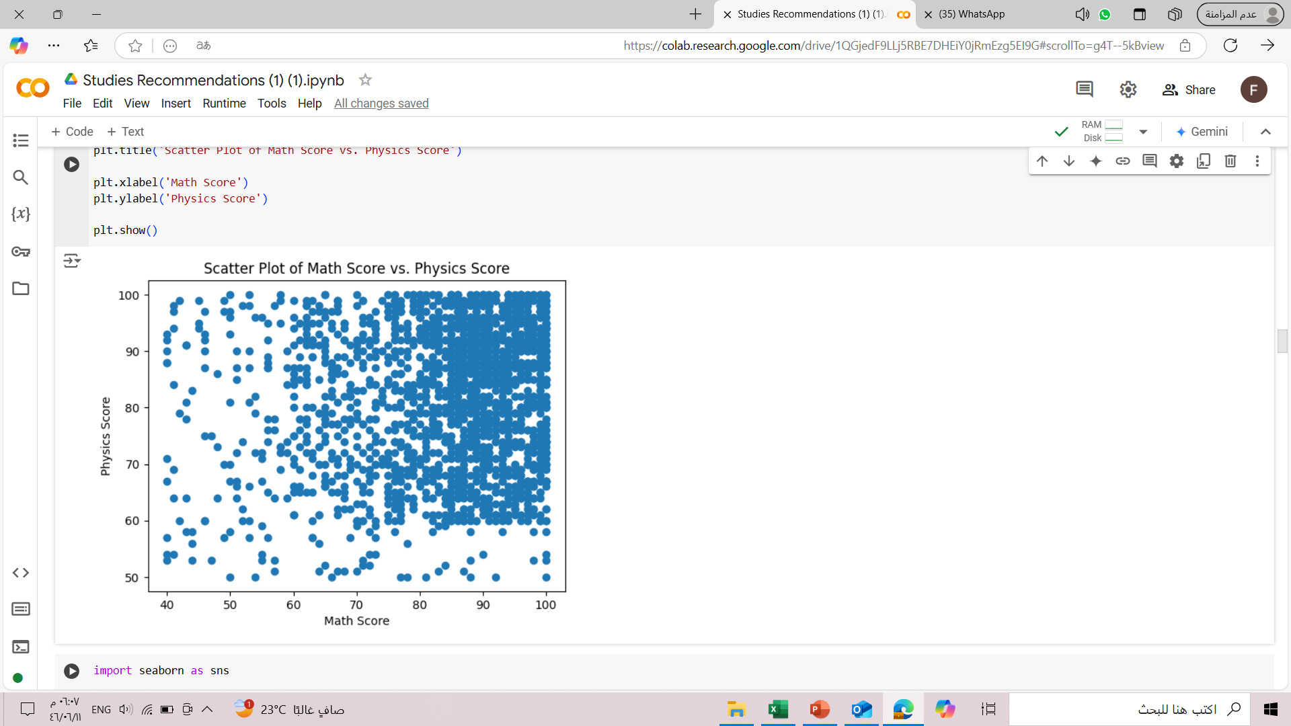
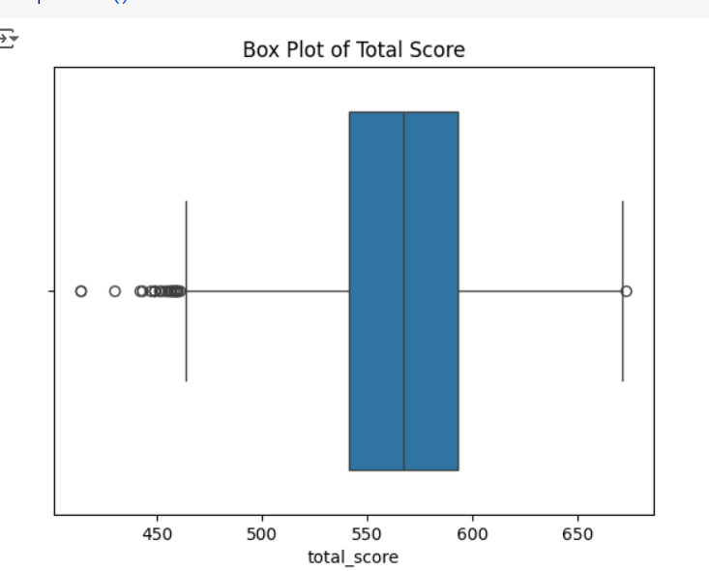
Visualization of student data
This box plot shows the distribution of students' total scores. It can be observed that the median total score is between 500 and 600, and that there are some outliers with scores greater than 600.
This histogram shows the distribution of students' average scores. It can be observed that most students achieved an average score between 75 and 85.
This scatter plot shows the relationship between math scores and physics scores. A positive correlation can be observed between the two scores, which means that students who achieve high scores in math tend to also achieve high scores in physics.

Slide 8
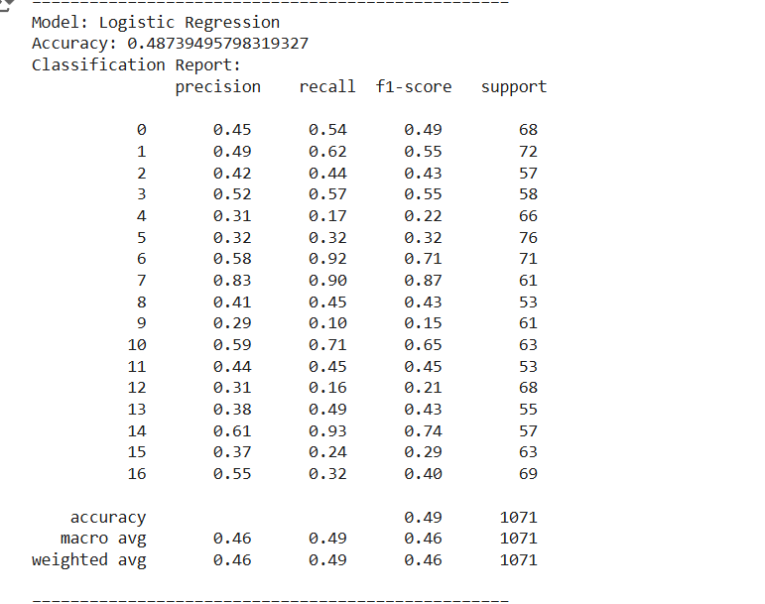
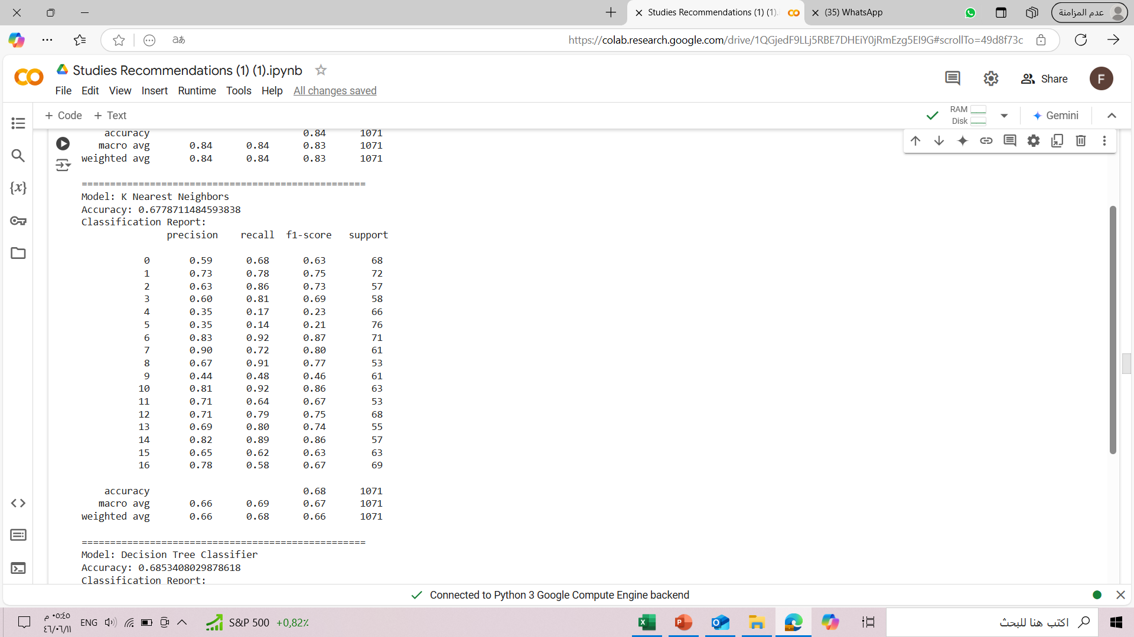
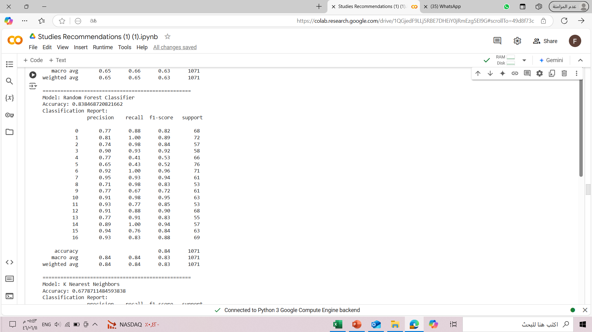
Comparing machine learning models:
Training multiple models on data:
Some of the evaluation results of machine learning models:
Comparing the performance of different models and choosing the best model that achieves the highest accuracy in predicting career aspiration:
Several metrics were used to evaluate the performance of the models, such as accuracy and classification report.

Slide 9
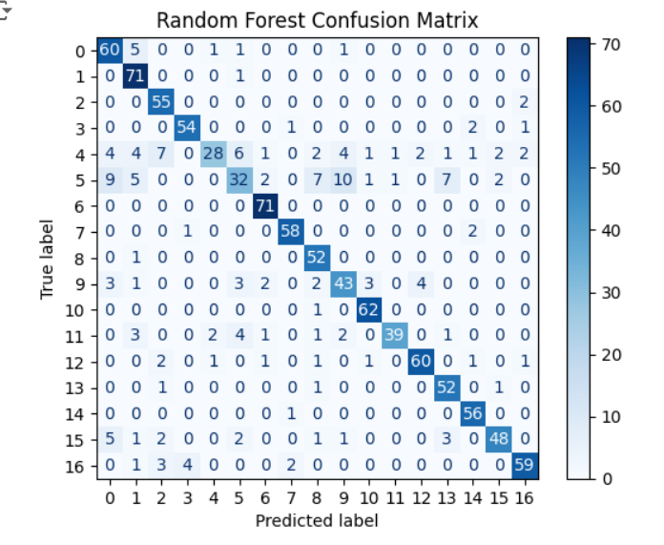
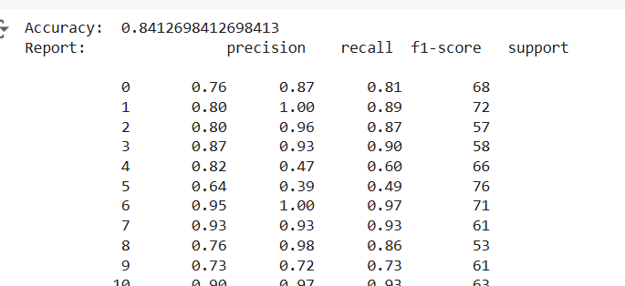
Model selection
Random Forest
By comparing the performance of the different models trained in the previous stage, the Random Forest model was selected because it achieved the best performance based on the evaluation metrics.

Slide 10
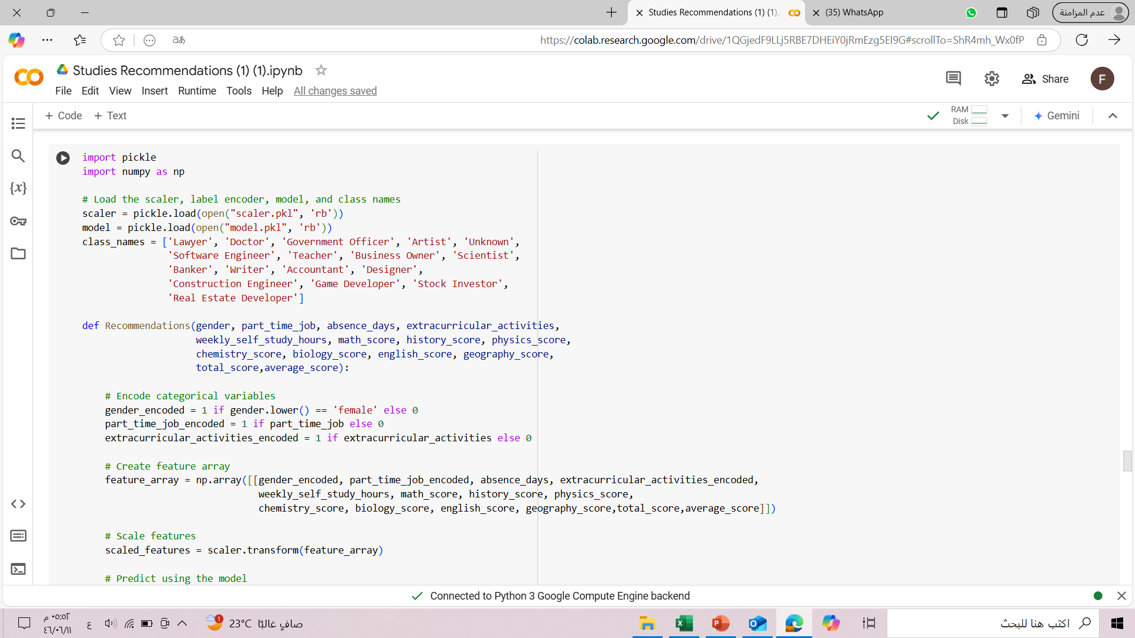
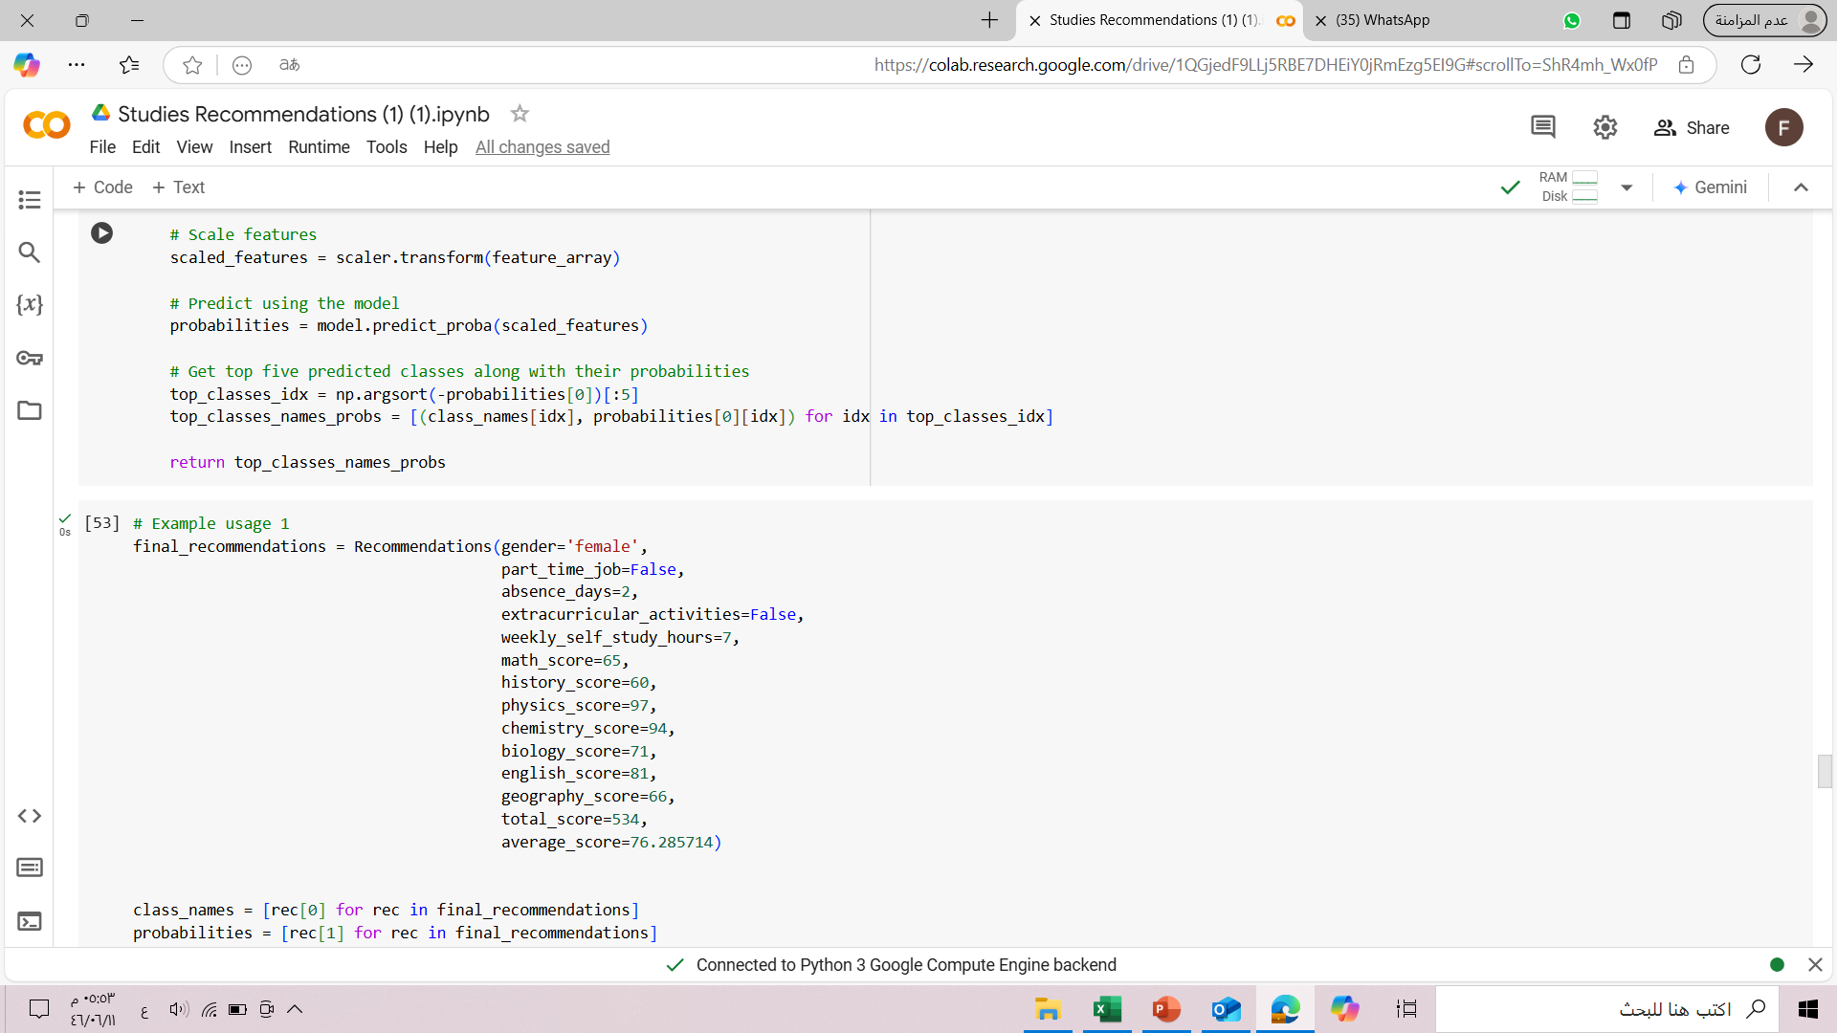
Building the recommendation system:
The recommendation system uses the Random Forest model chosen in the previous phase to predict students' career ambition.
The recommendation system predicts the probability of the student belonging to each job ambition category
.After that, the system arranges the categories by probability, and selects the top five categories as suggestions for the student.

Slide 11
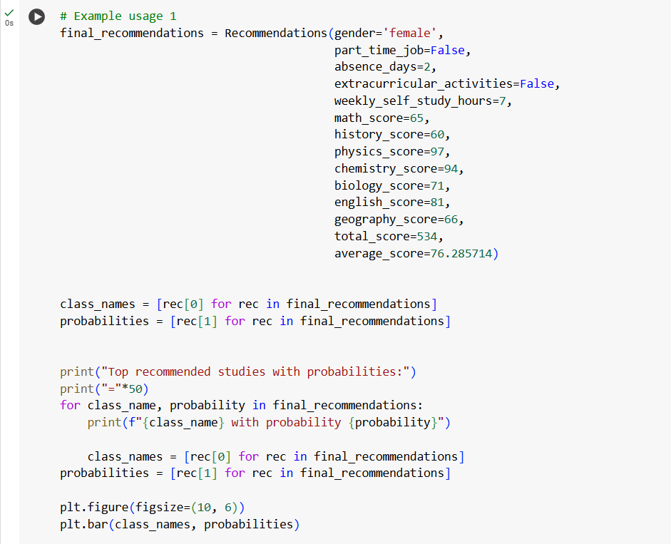
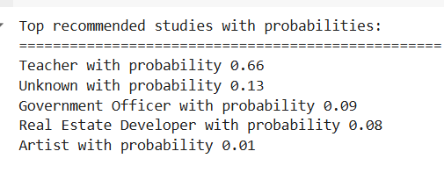
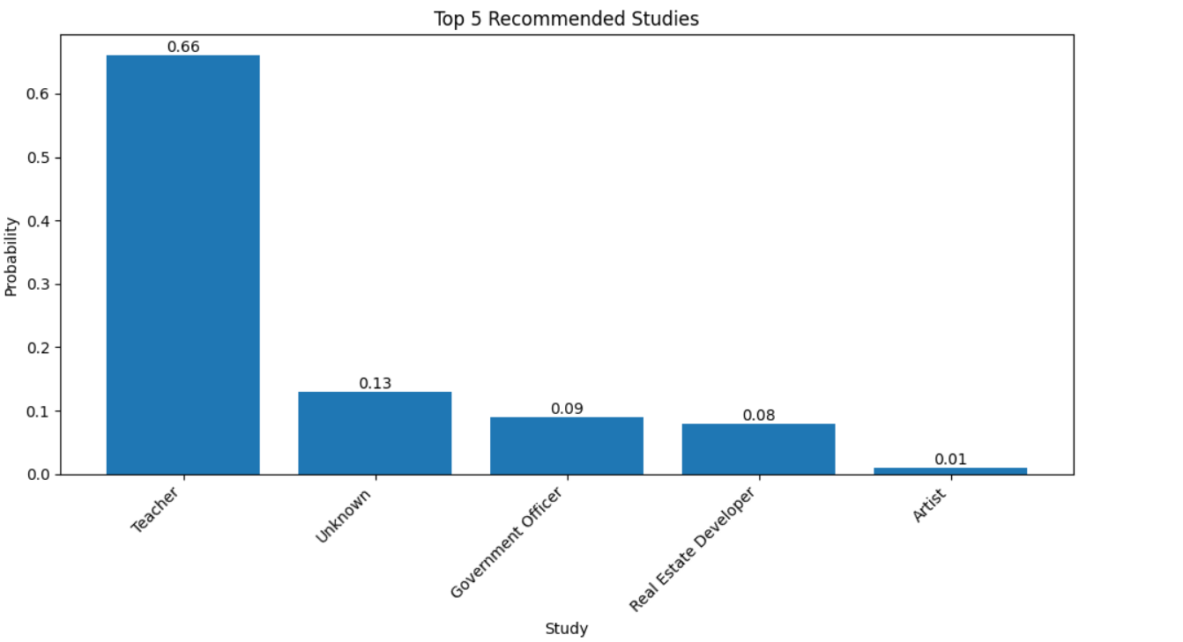
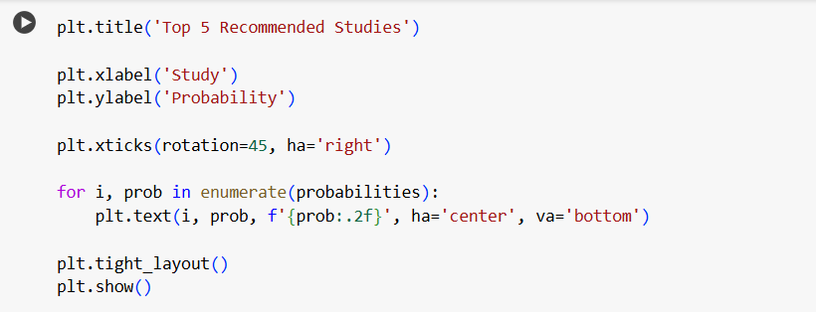
Example1

Slide 12
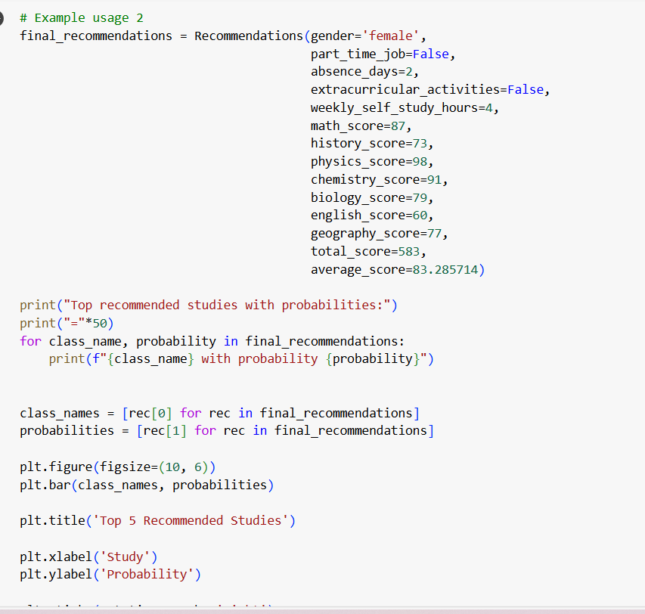
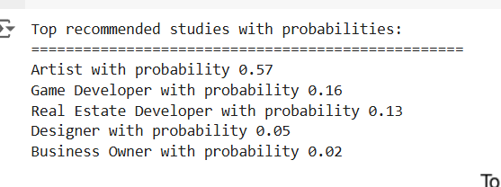
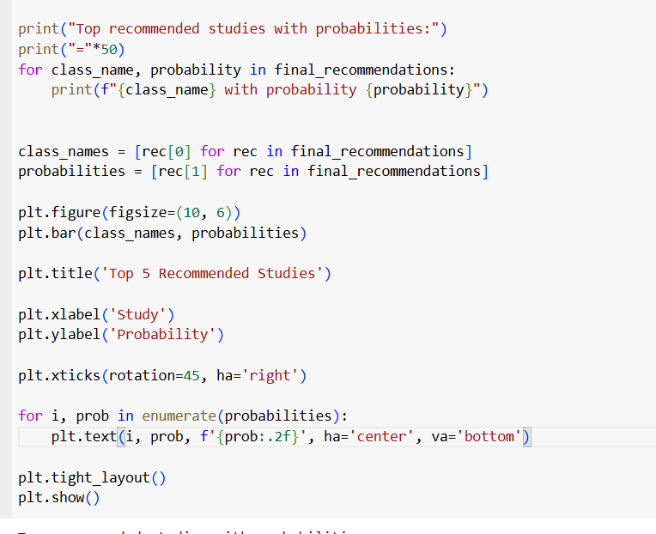
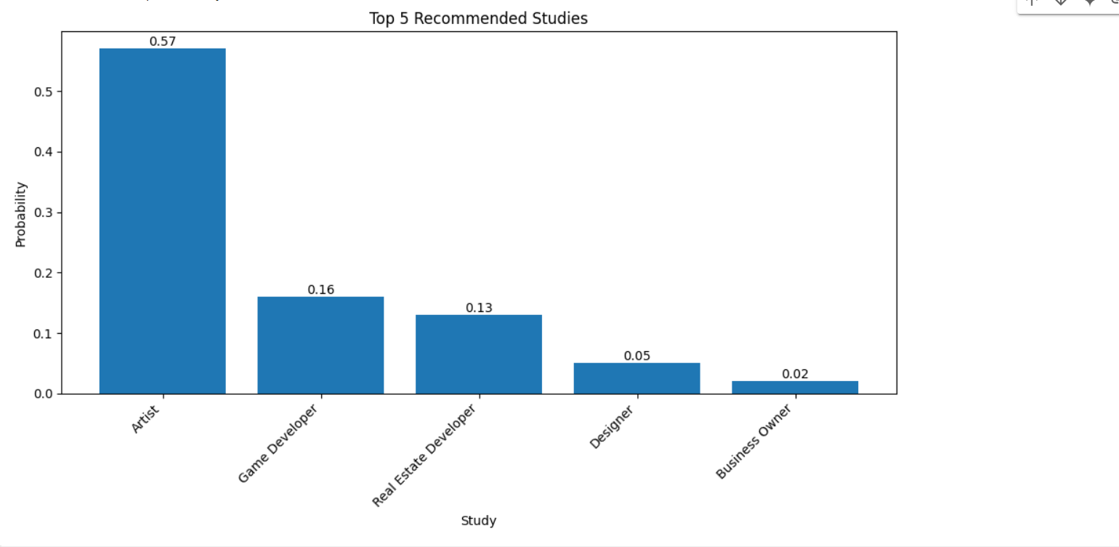
Example2

Slide 13
conclusion
In conclusion, we would like to emphasize the importance of building an intelligent system to predict students' career ambitions and provide them with personalized recommendations. We have reviewed the stages of building this system, starting with data collection and cleaning, through data encoding and balancing, to training machine learning models and choosing the best one.The results showed that the Random Forest model achieved the best performance in predicting career ambitions, and it was used to build a recommendation system capable of providing customized suggestions to students based on their data.We believe that this system can be a valuable tool to help students make informed decisions about their future careers, and can contribute to improving their chances of getting suitable jobs after graduation.

